Slide 1

Housekeeper Scheduling System
Presented TO: -
MPHASIS LEARNING ACADEMY
Presented BY: -
Members of Group 5 of DP Batch

Slide 2
Group No: 5(DP)
Team Lead:- Shraddha Rajguru
Group Members:-
Sumit Kumar
Harshal Jumnake
Mohd. Fahim Shaikh
Teki Jaswanth
Mohd Asra
Voira S. V. Pavan Kumar
Yalabolu Haripriya
Uppalapati Kumari
Anuka

Slide 3
OUTLINEs:-
Abstract
Objective
Project Architecture & Tech. Used
HTML & CSS
Angular
MySQL
Modules
ER and Class Diagram
Advantages and Disadvantages
Screenshots

Slide 4
Abstract:
The main objective of HOUSEKEEPER SHEDULING SYSTEM is to hostel students can use to get their rooms cleaned on time.
Admin will select a housekeeper and allots with a specific request coming from any student.
Using this HOUSEKEEPER SHEDULING SYSTEM Admin can Add, Edit and Delete housekeeper details like name, hostel, floor, rooms cleaned and complaints. Also, Enable or disable the housekeeper.
By using HOUSEKEEPER SHEDULING SYSTEM we can maintain the feedback and request status of the user.

Slide 5
Objective:
The function will automatically generate cleaning plans based on the number of rooms, number of staff and amount of time spent cleaning per room.
The housekeeping department takes pride in keeping the hotel clean and comfortable so as to create a ‗home away from home'. Good housekeeping is considered as the backbone of accommodation sector as its main aim is to provide a clean comfortable, safe and aesthetically appealing environment.

Slide 6
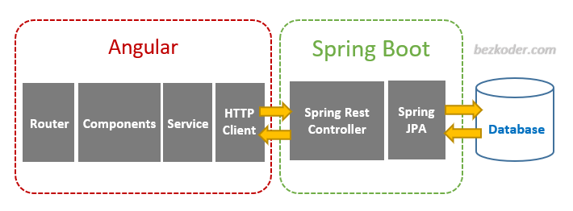
Project Architecture:

Slide 7
Tools & Technologies Used:
Front-End : Angular
Server-side : Spring Boot
Back-end : MYSQL, Hibernate
Server : Tomcat

Slide 8
HTML & CSS:
HTML (the Hypertext Markup Language) and CSS (Cascading Style Sheets) are two of the core technologies for building Web pages.
HTML provides the structure of the page, CSS provides the layout for a variety of devices.
Along with graphics and scripting, HTML and CSS are the basis of building Web pages and Web Applications.
HTML is the language for describing the structure of Web pages and CSS is the language for describing the presentation of Web pages, including colors, layout, and fonts.

Slide 9
Angular:
Angular is a platform and framework for building single-page client applications using HTML and TypeScript.
Angular is written in TypeScript. It implements core and optional functionality as a set of TypeScript libraries that you import into your applications.
The architecture of an Angular application relies on certain fundamental concepts. The basic building blocks of the Angular framework are Angular components that are organized into NgModules.

Slide 10
MySQL:
MySQL is currently the most popular database management system software used for managing the relational database.
It is open-source database software, which is supported by Oracle Company.
It is fast, scalable, and easy to use database management system in comparison with Microsoft SQL Server and Oracle Database.
MySQL follows the working of Client-Server Architecture. This model is designed for the end-users called clients to access the resources from a central computer known as a server using network services.

Slide 11
Modules:
The system comprises of 2 major modules with their sub-modules as follows:
Admin:
Login: Admin can login Into account.
Dashboard: Where all the details will be displayed.
Allot: Admin can allot a housekeeper.
Complaints: Complaints which are raised by the user are displayed.
Suggestions: Suggestions which are given by the user are displayed.
Register Student: Admin can register a new student.
Register Housekeeper: Admin can register a new housekeeper.
Logout: Admin can logout after the completion of his work

Slide 12
User Module:
Login: User can login into user account.
Dashboard: Where all the details will be displayed.
Requests: User can request a housekeeper by selecting date and time.
Feedback: User gives the feedback like suggestions and complaints about the housekeeper performance.
Profile: contains Details of the User.
Logout: User can logout after the completion of work.

Slide 13
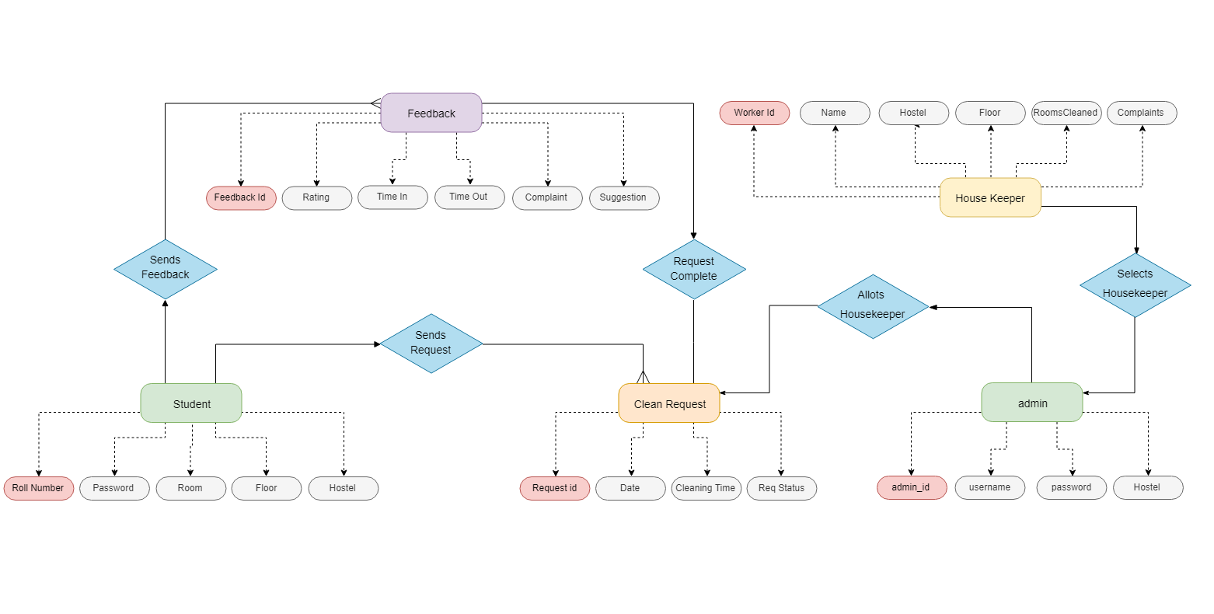
Class Diagram:

Slide 14
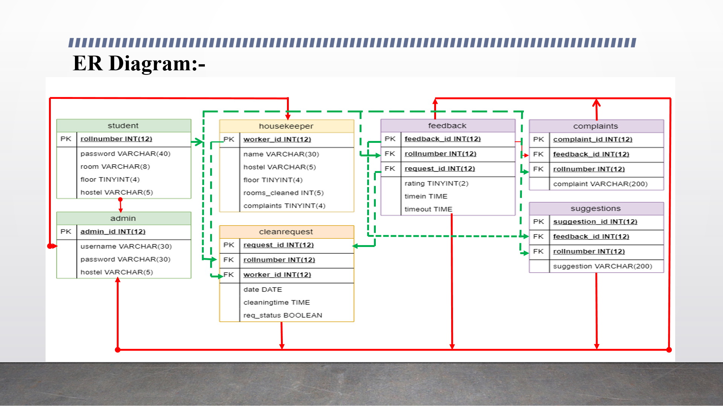
ER Diagram:

Slide 15
Advantages:
This system is very easy to understand and user friendly.
Student and Hostel Warden are connected with each other on one system.
This system is saving the time for student and hostel warden too.
In this system user can connect any time whenever he/she wants.
This system is secure.

Slide 16
Disadvantages:
Privacy issues
One Vendor Dependency
Not For Individuals as it will be costly.
Technology Dependency

Slide 17
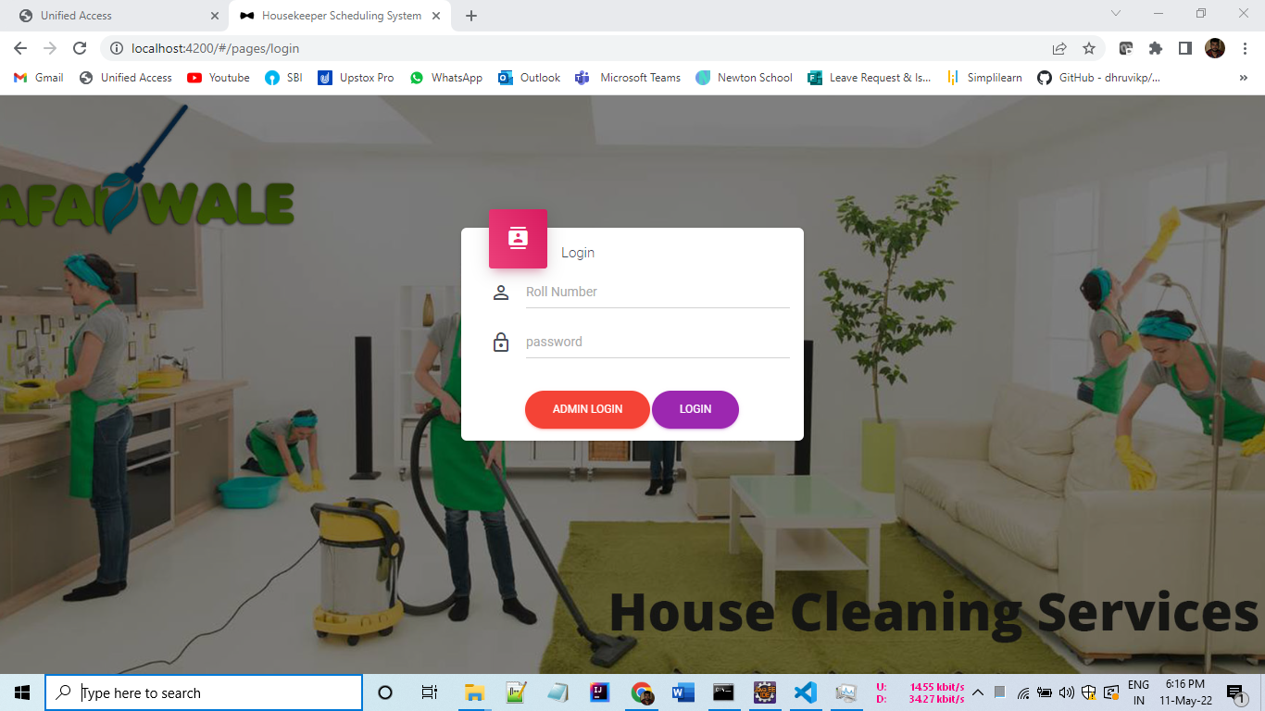
Screenshots:(Login page:)

Slide 18
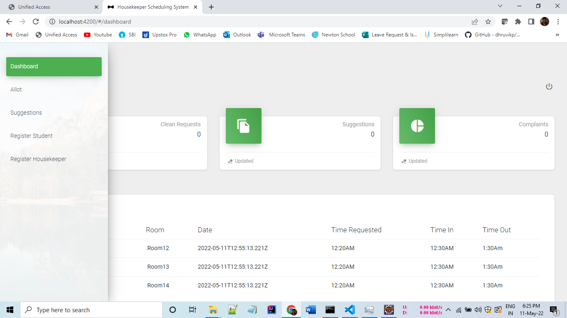
Admin Dashboard:

Slide 19
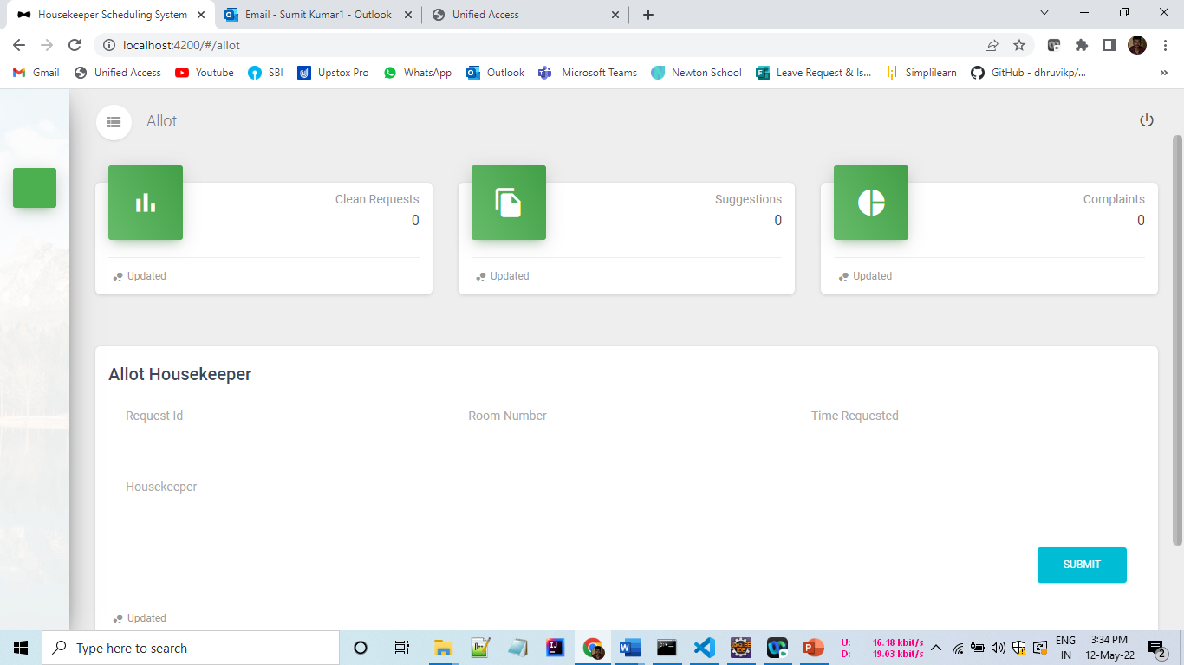
Allot Housekeeper:

Slide 20
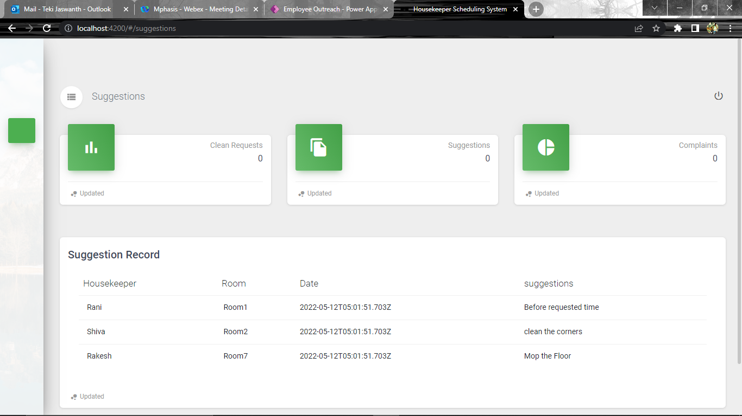
Suggestions:

Slide 21
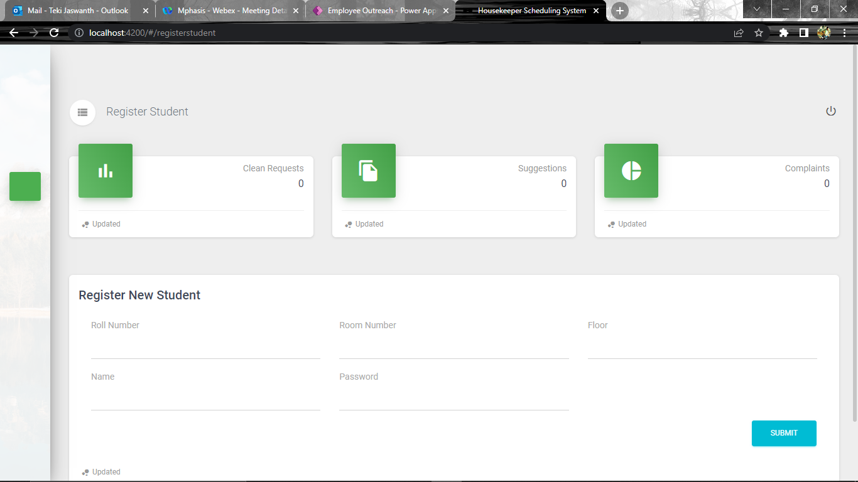
Register New Student:

Slide 22
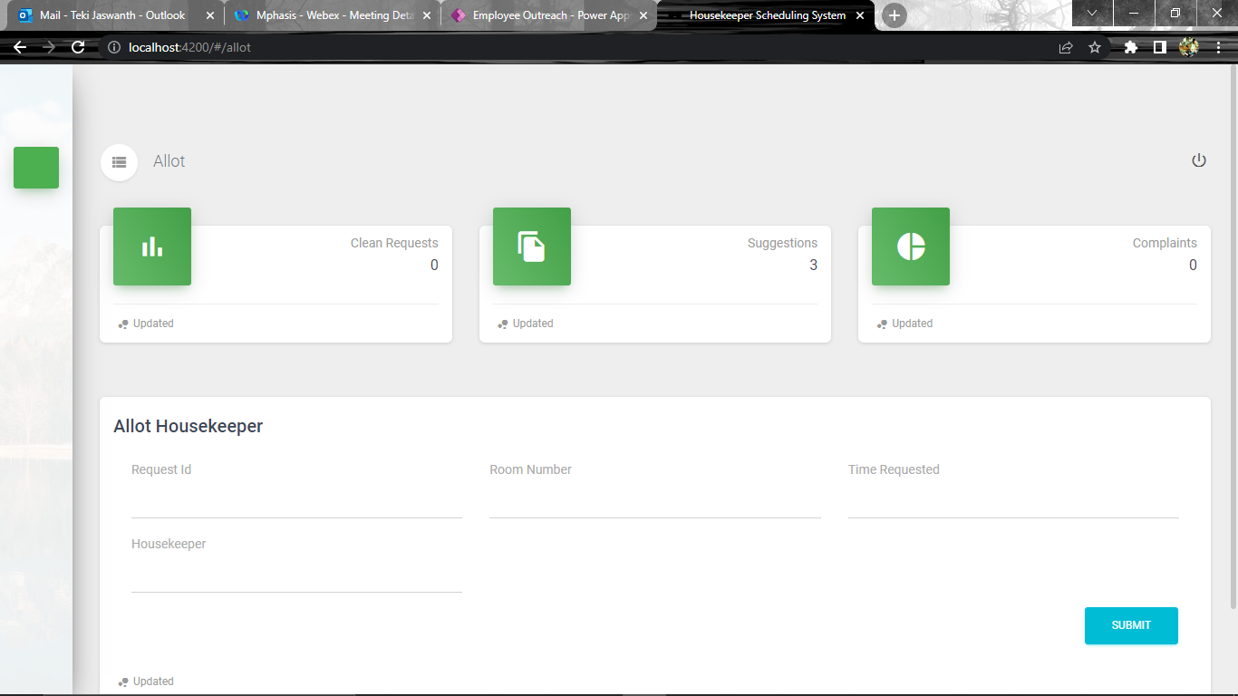
Housekeeper Registration:

Slide 23
Conclusion:
HOUSEKEEPING SCHEDULING SYSTEM direct and controls housekeeping operations and staff of the department.
It co-ordinate between staff and users to inspect assigned areas to ensure standards are met.
This system develops a new trends serves to meet user expectations, enhance service delivery and improve efficiency .
This system will perfectly suit to Hotels and School-College’s Hostel for Cost effectiveness.

Slide 24
Future Scopes:
We can add Payment methods.
Can make More Interactive platform.
Can add a component so that Housekeeper can communicate with admin.
Can Develop a mobile application so that it will be easy accessible.

Slide 25


